Slide 1
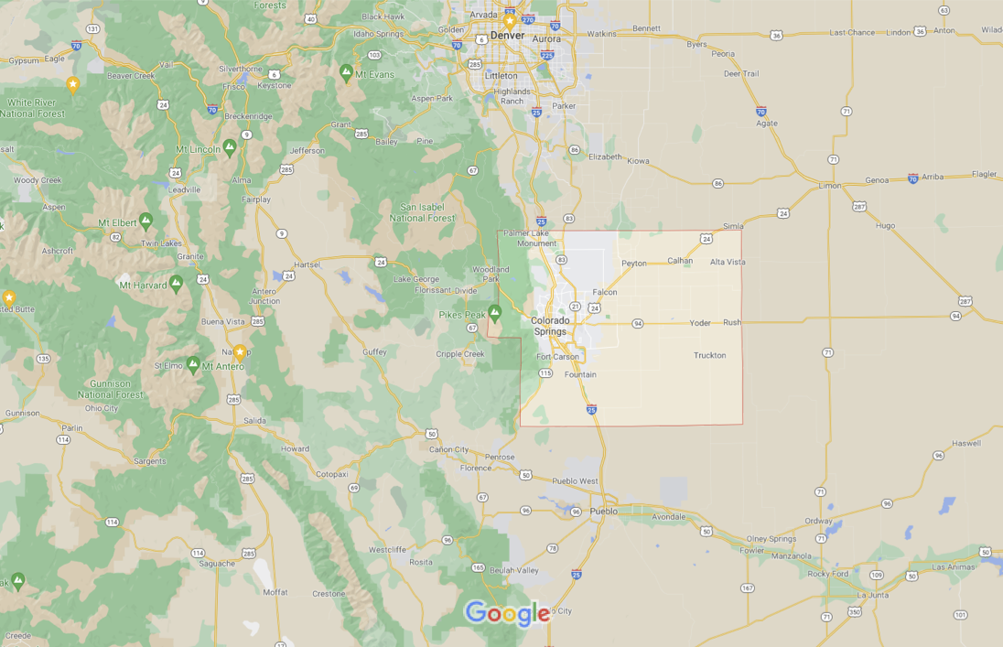
PyStars
El Paso County, CO
Exploration of select factors and their relationship with the price of real estate in 2021

Slide 2
Introduction
Notes:
Christine

Slide 3

Notes:
Christine

Slide 4
Hypotheses
What really does affect the cost of housing in any area?
Schools:
Null: The existence of a nearby school has no effect on the sale price of a house. The quality of a nearby school has no effect on the sale price of a house.
Alt: Having a school nearby should increase sale prices. The higher the quality of a nearby school, the higher the sale price should be.
Walk Score:
Null: An increase in a house’s walk score should have no effect on its sales price.
Alt: An increase in a house’s walk score should positively affect its sale price and increase it.
Notes:
Christine
-give credit where it’s due

Slide 5
Resources
Websites
Housing Sales: http://18.223.18.233:8080/re6Rest/api/query/allhouses
Solar Permits: https://www.pprbd.org/Information/Reports
Walk Score: https://www.walkscore.com/professional/api.php
School Diggers: https://developer.schooldigger.com/docs
Geocoding: https://developers.google.com/maps/documentation/geocoding/overview
Cool Intros: https://starwarsintrocreator.kassellabs.io/
Api Keys: None of your business!
Notes:
Christine

Slide 6
Data Exploration
Sale Price ($) vs. Dollar Per Square Feet ($ / ft²)
“Total Price vs. Unit Price”
Standardizes all houses to one value of measurement
Takes out common size and price correlation
Help more accurately measure correlation between the variables
Methodology:
Use Geocoding API for latitude and longitudes of houses
Use Walk Score API for walk score of each house
Use Schooldigger API for school rank of nearest school
Use Pikes Peak Regional Building Permit data and custom housing API to compare houses sold to houses with solar panels installed
Notes:
2 variables used to compare home prices. Absolute Size vs Price using the factors as conditions. Standardize all home’s value by assigning them a dollar/sq ft number.

Slide 7
Factor #1: Walk Score
By using the walk score API, we were able to determine the walkability of each address via the housing sales data. Based on a variety of factors and how each one ranks per home, we were then able to analyze how the walk score affects overall sale price and time on market.
Walk Score measures the walkability of any address
Transit Score measures access to public transit
Bike Score measures whether a location is good for biking.
The combination of these factors and their individual rankings help determine the ideal buyer for the home as well as help buyers decide what is the best fit for them.
Notes:
Will

Slide 8
Factor #2: Schooldigger Rating
The Schooldigger API helps individuals evaluate school performance and quality.
First, we wanted to know if the fact that the house is closeby to a high/middle/elementary school would affect the overall sale price.
Secondly, we wanted to know if the Schooldigger rating affects the true value of the home and it’s listing price on market.
Notes:
Will

Slide 9
Factor #3: Solar Panels
What relationship did a solar pv system have on a home’s sale price?
"On average, solar panels raise a home’s value by 4.1% across the U.S., according to a new Zillow analysis of homes across the country— that’s a boost of $9,274 on a $226,300 home, according to the study.”
https://money.com/home-value-solar-panels/
“Team of Appraisers Across Six States Find Home Buyers Will Pay Premium for Solar Homes:
Results Confirm Earlier Berkeley Lab Large-Scale Study”
https://newscenter.lbl.gov/2015/11/12/premium-for-solar-homes/
Notes:
Will

Slide 10
Analyses
Notes:
WiIl

Slide 11
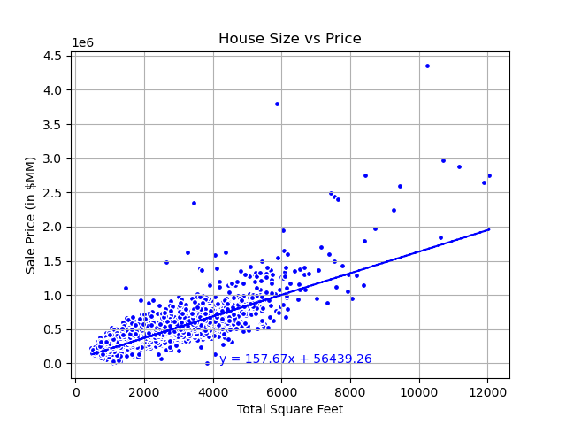
Base Graph:
Positive correlation between house size and sale price.
Notes:
Baseline Graph showing common knowledge, bigger the house, higher the cost.

Slide 12
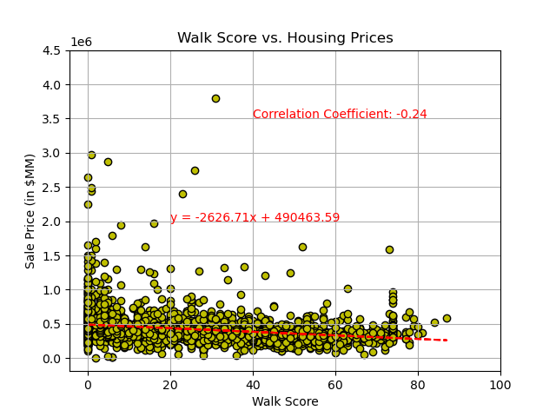
Walk Score vs
Price
Very slight negative correlation between walk score and sale price
Notes:
Walkability in relation to the price of the address shows that the lower the score the more likely cheap houses would be purchased.

Slide 13
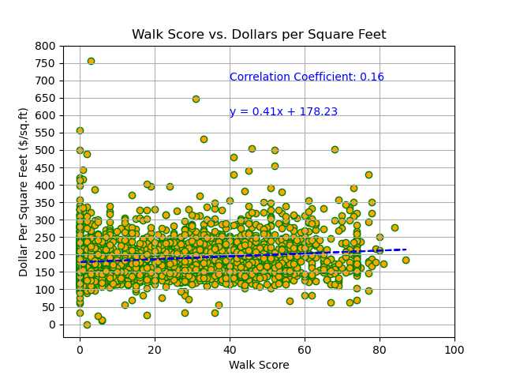
Walk Score vs Dollars/Sq Feet
Almost negligible correlational relationship between walk score and Dollars per Square Feet
Notes:
Walkability in relation to the price of the address shows that the lower the score the more likely cheap houses would be purchased.

Slide 14
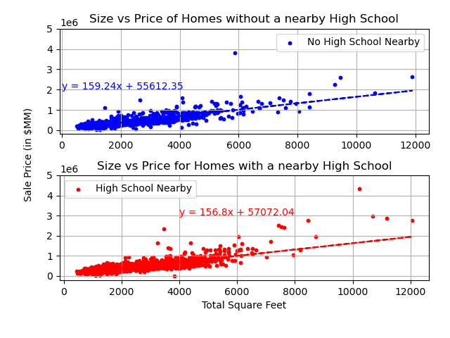
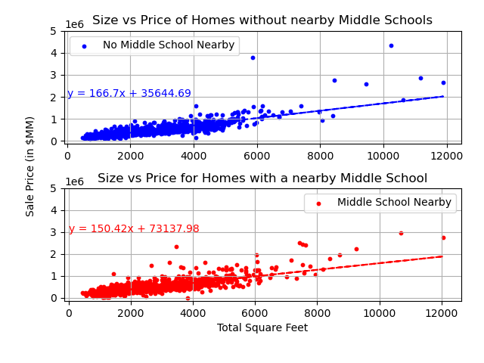
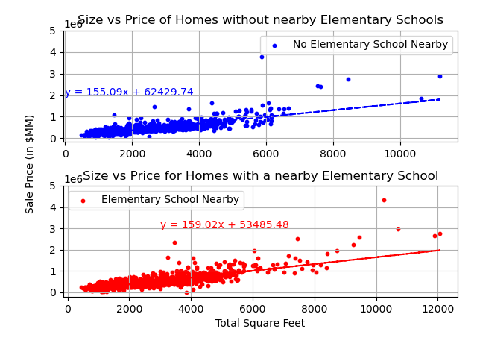
(School vs No School)
Subplots
Total Sale Price ($)
Total Square Feet
Notes:
Walkability in relation to the price of the address shows that the lower the score the more likely cheap houses would be purchased.

Slide 15
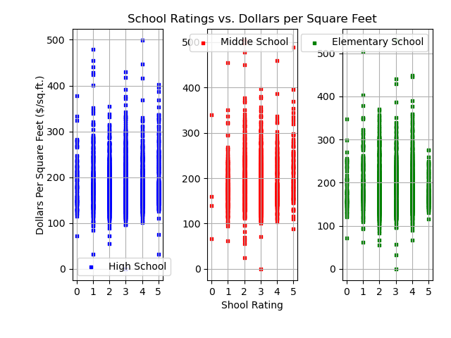
School Rank vs. Dollars/Sq Feet
Each ‘Rank’ has multiple homes with a diverse Dollars/SqFt value
Notes:
Attempt to scatter plot School Rank against a home’s dollar/sq ft value

Slide 16
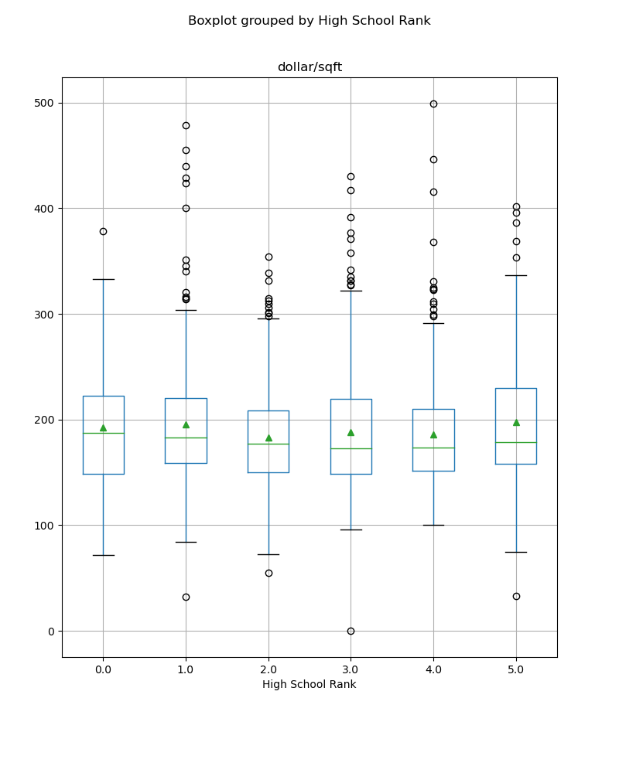
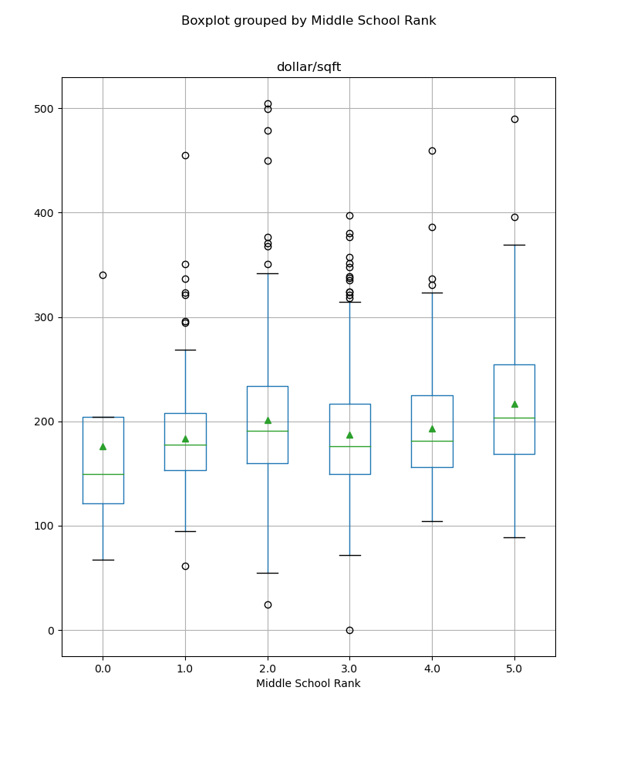
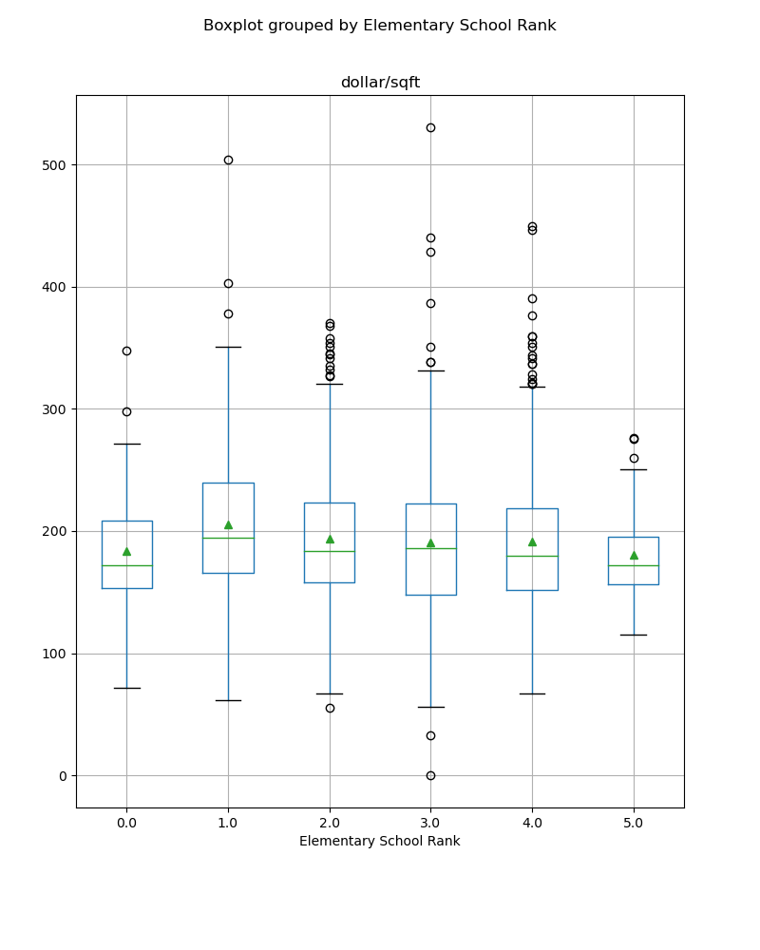
School Rank vs. Dollars/Sq Feet Cont.
Box Plots show the relative similarity between each ‘Rank’
Notes:
Box Plot of the previous graph

Slide 17
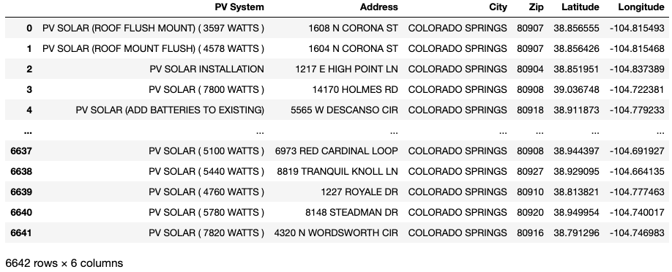
Solar PV
Notes:
> 6k homes had a system installed over the last five years …
... yet, only one of those homes was sold this year …
... thus no analysis was performed...

Slide 18
Possible Improvements

Slide 19
Possible Improvements
Different Parameters for Finding Schools
Different Distance
Sort By Rank/Rating instead of Distance
Use the Ranks instead of Ratings
Different Dependent Variable (Time on Market rather than Price)
Looking at a different time frame
pre-COVID-19 housing sales
Narrow focus
County -> Subareas, Neighborhoods, etc.
Staged vs non staged homes
Interview agents and / or review photos
Notes:
Christine / Rob

Slide 20
Closing Statement
Forced to accept the Null Hypothesis
Housing Prices is a multi-faceted topic that requires lots of data along with very detailed and granular methodology.
Hard to extract correlations let alone causations from such a broad topic.
Further research required
Lots of controls needed for viable data

Slide 21

PyStars
Out!

